Slide 1
Document Based Query Suggestion and Auto Completion

Slide 2
Huge Data over internet
Need to include them in query suggestions
n^2/2 different n-grams
Need a eifficient n-gram model

Slide 3
Suffix Automata
Recent and Popular algorithm
Makes a DAG from a string

Slide 4
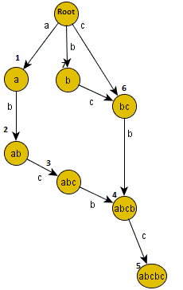

Slide 5
Why this algorithm?
Words Can be identified as integers.
Automata for several array of integers.
Time and memory complexity of preprocess O(n)
Getting the frequeny of an n-gram quite easily in runtime O(1)

Slide 7
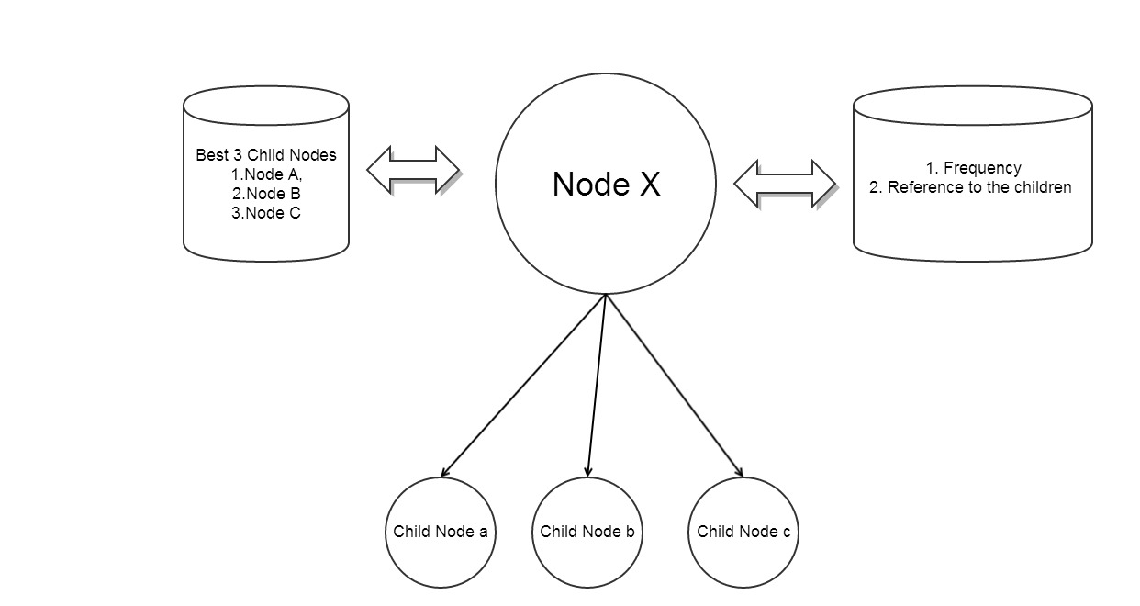
Preprocess and storage

Slide 8
Making candidate suggestions
RDSN (Retrieval of direct suggestion from a Node method)
Number of extra words in an RDSN candidate = (number of words in this RDSN candidate-1)/3+1
Number of words in an RDSN candidate is= (number of words in Q-1) to (number of words in Q+3)

Slide 9
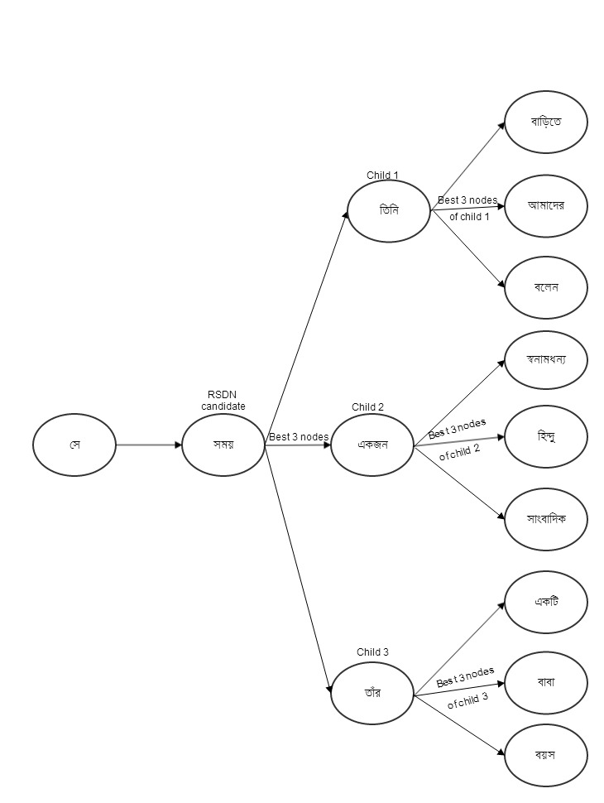
Rdsn METHOD

Slide 10
Close Match Ratio, CMR= (number of words both in CQ and Q /number of words in Q).
Weight Match Ratio, WMR= (weight of CQ/ weight of Q
Weight of a query, WQ= Sum of the weight of each individual words of the query.
The weight of a word WW which is present in input query, Q = 1/ the total frequency of the word in all the documents.
If a word is not present in Q, then WW of the word is 0.

Slide 11
Sorting suggestions
Exact Prefix Match
Partial Prefix Match
Serial Match
Good WMR and CMR values of a CQ

Slide 12
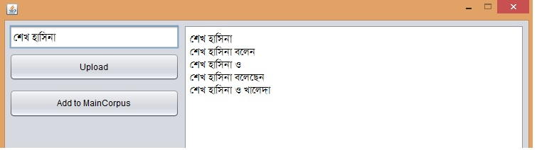
Exact Prefix match

Slide 13
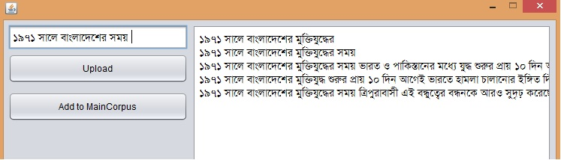
Parital Prefix and serial match

Slide 14
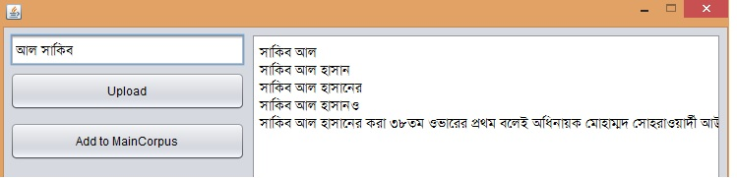
Good WMR and CMR values of a CQ

Slide 15
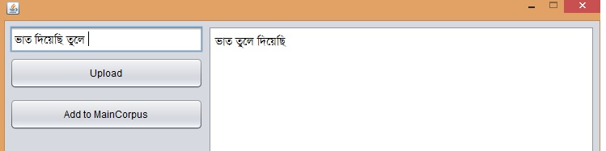
Grammar check

Slide 16
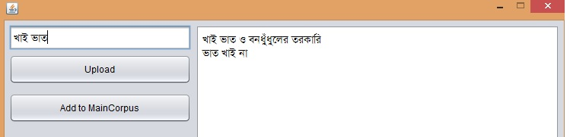

Slide 17
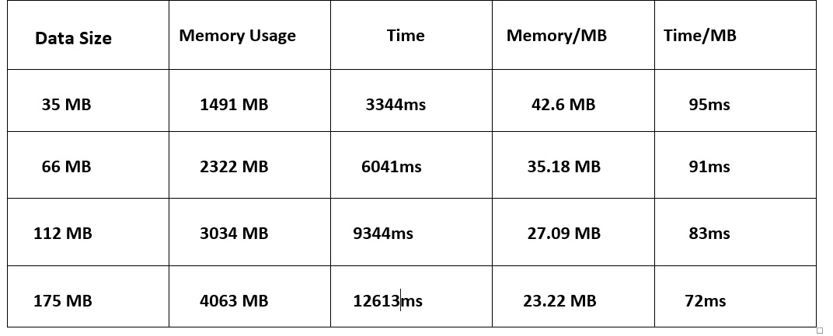
Performance Anaylsis

Slide 18
Future work
Root word
Increase the weight of the n-grams of the most popular and the recently visited documents

Slide 19
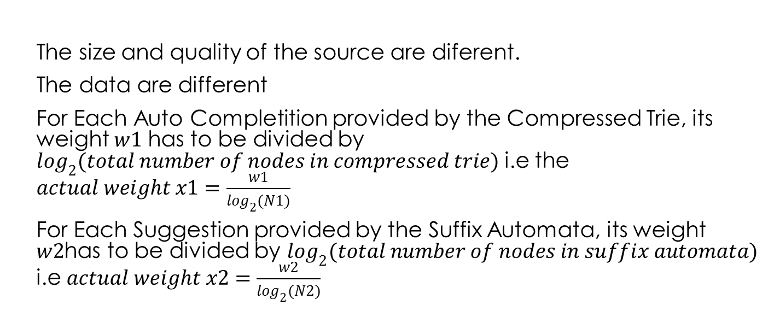
Final result
The size and quality of the source are diferent.
The data are different
For Each Auto Completition provided by the Compressed Trie, its weight $w1$ has to be divided by $\log_{2}{(total number of nodes in compressed trie)}$ i.e the $actual weight x1=\frac{w1}{\log_{2}{(N1)}}$
For Each Suggestion provided by the Suffix Automata, its weight $w2$has to be divided by $\log_{2}{(total number of nodes in suffix automata)}$ i.e $actual weight x2=\frac{w2}{\log_{2}{(N2)}}$

